Slide 1
ACCESSING LINUX FILE SYSTEMS

Slide 2
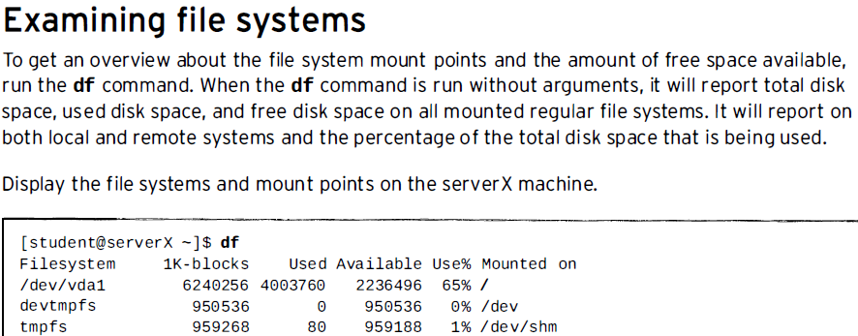

Slide 3
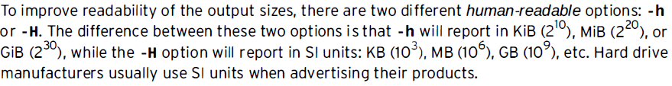
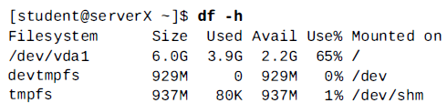

Slide 4
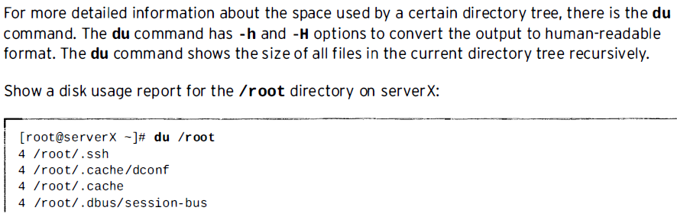

Slide 5
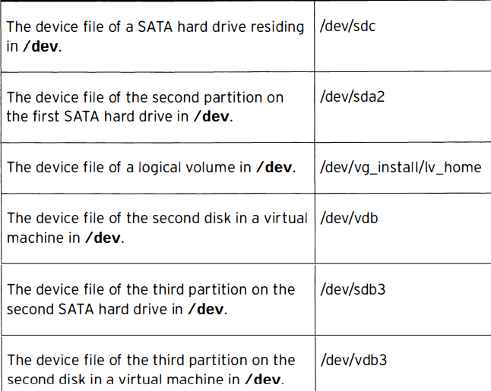

Slide 6
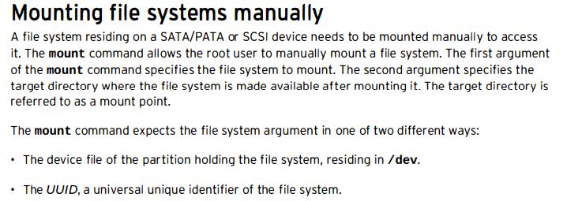

Slide 7
Mount and unmount
The blkid command gives an overview of existing partitions with a file system on them and the
UUID of the file system, as we ll as the file system used to format the partition.
[root@serverX -]# blkid

Slide 8
Mount and unmount
A file system can be mounted on an existing directory. The /mnt directory exists by default and provides an entry point for mount points.
It is used for manually mounting disks.
It is recommended to create a subdirectory under /mnt and use that subdirectory as a mount point unless there is a reason to mount the file system in another specific location in the file system hierarchy.

Slide 9
Mount and unmount
Mount by device file of the partition that holds the file system.
[root@serverX -]# mount /dev/vdb1 /mnt/mydata
Mount the file system by universal unique id, or the UUID, of the file system.
[root@serverX -]# mount UUID="46f543fd - 7Bc9 - 4526 - a857 · 244811be2dBB" /mnt /mydata

